Slide 1
Denver AWS Meet-Up: Cognito Basics
Presentation by Ben Libell
August 2018
Notes:
The Studio PowerPoint Templates page: https://sp.slalom.com/ourfirm/studio/SitePages/templates.aspx

Slide 2
Agenda
What is Cognito?
User Pools and Clients
Setup Your First User Pool
Cognito JavaScript API
Cognito in your App
Potential Pitfalls

Slide 3
What is Cognito?
Cognito is a self contained Identity and Access Management tool provided by Amazon Web Services
Manage your users
Easy Authentication Across App
JWT Session Management
Full CLI Suite
Manage User Pool Access with App Clients
Leverage Amazon Infrastructure for Scalability
APIs for many languages
MFA Compatibility

Slide 4
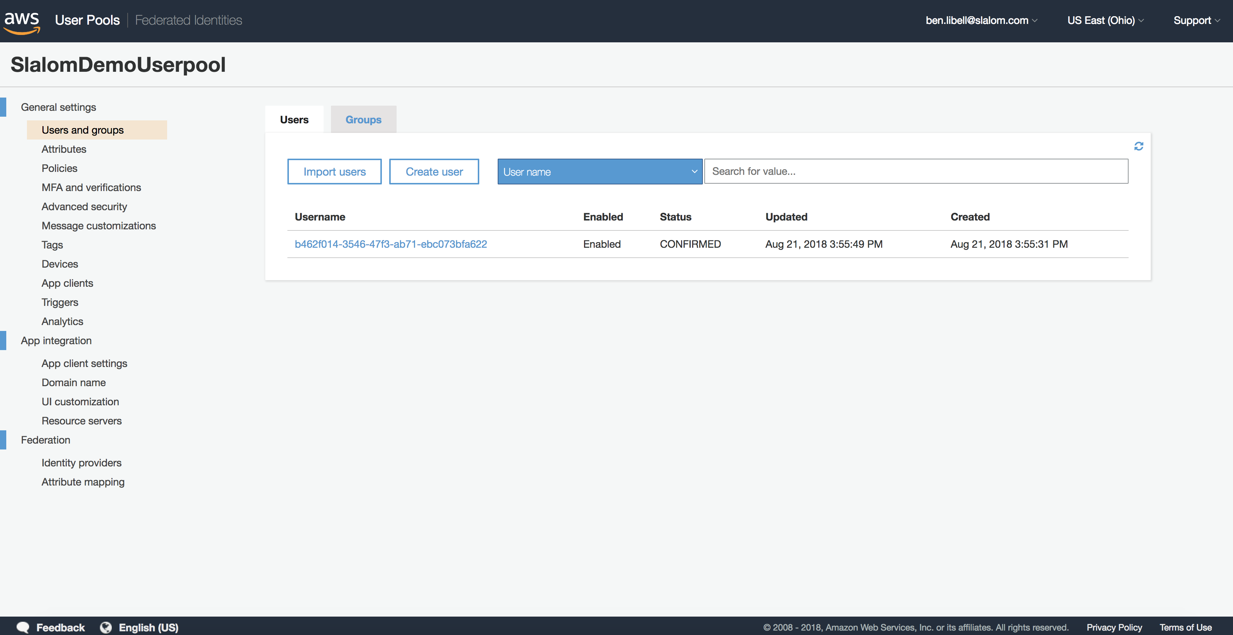
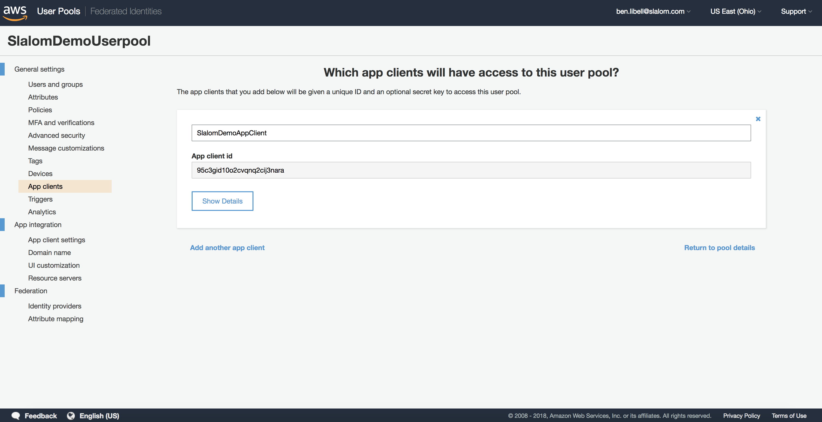
Cognito User Pools and Clients
Two parts of the User Identity whole…
1
User Pools
2
App Clients
Cognito User Pools are where Cognito stores user information including usernames, emails, passwords, and custom attributes…
App Clients are required for your Applications to interact with your user pool. Permissions for your pool can be set per app with multiple clients
Notes:
Click the icon and navigate to your photo on your computer
Crop and position photo as desired
Go to the Arrange drop down menu > choose “send to back” to reveal text

Slide 5

Let’s set up a new User Pool!

Slide 6
Cognito JavaScript API
Bringing Cognito into your Web App
The Amazon supported JS API for interfacing with Cognito can be found here:
https://github.com/aws-amplify/amplify-js/tree/master/packages/amazon-cognito-identity-js
The API is part of the greater aws-amplify package and can be installed on its own or as part of the greater library
The API provides client facing methods for interfacing with your user-pools
It allows end users to manage their own Cognito accounts without exposing administrative AWS commands through your app
While what is available in this API is by no means exhaustive it does have hooks for most user facing Cognito functionality from simple things like login, to more complicated things like MFA authentication or SMS notifications

Slide 7

Let’s look at a Node.js App using Cognito
slalom.com
Notes:
Click photo > delete
Click the icon and navigate to your photo on your computer
Crop and position photo as desired
If the text has disappeared, go to the Arrange drop down menu > choose “send to back” to reveal text

Slide 8
Potential Pitfalls
Things you should consider before choosing Cognito
1
2
3
No Roll-Over or Migration
Schema Locked
Rigid JWT Structure
Out of the box, Cognito does not provide any means of rolling users from one User-Pool to another
While you are able to add custom attributes to a User-Pool after it’s creation they can not be required and attributes can not be taken away. Additionally many properties are locked in during User-Pool creation
The types and structures of the JTWs issued by Cognito are not customizable beyond adding individual custom attributes to the Identity Token only
4
5
Limited Message Customization
6
Password Restrictions
Limited User Admin UI
There used to be a restriction on passwords disallowing = and + signs from being used. While this isn’t any longer valid as Amazon has fixed this specific issue, it is a good example of quirkiness that can be found in Cognito.
While it’s possible to customize communication from Cognito it becomes increasingly difficult as you add complexity (custom email templates etc…)
The Cognito web UI allows for some management of the user pools and app clients but full manipulation does require knowledge of the AWS CLI

Slide 9
Thanks for joining us tonight

